Slide 1
Java data structure
Session 3 - 4
D6421 – Muhammad Fikri Hasani

Slide 2
Outline
Course outline
introduction
Arraylist
HashSet
HashMap

Slide 3
Java data structures
introduction
Other than array and string, and also basic variable type, java contains some additional data structure that can help developer when building its application
Some of them are ArrayList, HashSet, HashMap
All of them has its own characteristics and use cases

Slide 4
Java data structures
arrayList
ArrayList made to overcome the problems faced by the Array in determining its size because it is a dynamic ArrayList.
The following functions are frequently used in the ArrayList class
  add(element) → adding element to the list
  clear() → delete all element in the list
  clone() → returns the copied object in the list
  contains(element) → searching element contains in the list
  get(index) → take a certain element at index in list
  isEmpty() → to check whether the list is empty or not
  remove(index) → to remove the designated element in the list
  size() → number of element in the list
  set(index, element) → fill an element in the list in accordance with the designated position

Slide 5
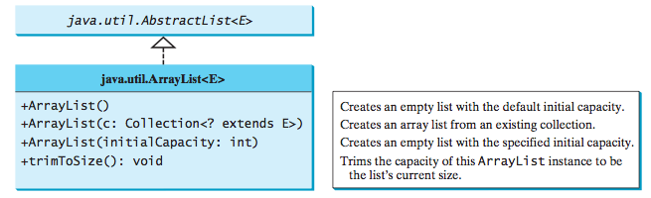
Java data structures
arraylist

Slide 6
Java data structure
import java.util.ArrayList;
class Main {
public static void main(String[] args) {
// create an ArrayList object called fruits
ArrayList<String> fruits = new ArrayList<String>();
// add elements to the fruits ArrayList
fruits.add("Apple");
fruits.add("Banana");
fruits.add("Cherry");
fruits.add("Date");
// remove an element from the fruits ArrayList
fruits.remove(1);
// get the size of the fruits ArrayList
System.out.println("Size of fruits: " + fruits.size());
// loop through the fruits ArrayList using a for loop
System.out.println("Fruits using for loop:");
for (int i = 0; i < fruits.size(); i++) {
System.out.println(fruits.get(i));
}
// loop through the fruits ArrayList using a for-each loop
System.out.println("Fruits using for-each loop:");
for (String fruit : fruits) {
System.out.println(fruit);
}
}
Arraylist Example
// import the ArrayList class
import java.util.ArrayList;
class Main {
public static void main(String[] args) {
// create an ArrayList object called fruits
ArrayList<String> fruits = new ArrayList<String>();
// add elements to the fruits ArrayList
fruits.add("Apple");
fruits.add("Banana");
fruits.add("Cherry");
fruits.add("Date");
// access an element from the fruits ArrayList
String firstFruit = fruits.get(0);
System.out.println("First fruit: " + firstFruit);
// change an element in the fruits ArrayList
fruits.set(3, "Dragonfruit");
System.out.println("Fruits after change: " + fruits);
}
}

Slide 7
jAva data sructures
hashset
The HashSet class is a concrete class that implements Set.
You can create an empty hash set using its no-arg constructor, or create a hash set from an existing collection
A HashSet can be used to store duplicate-free elements.
For efficiency, objects added to a hash set need to implement the hashCode method in a manner that properly disperses the hash code

Slide 8
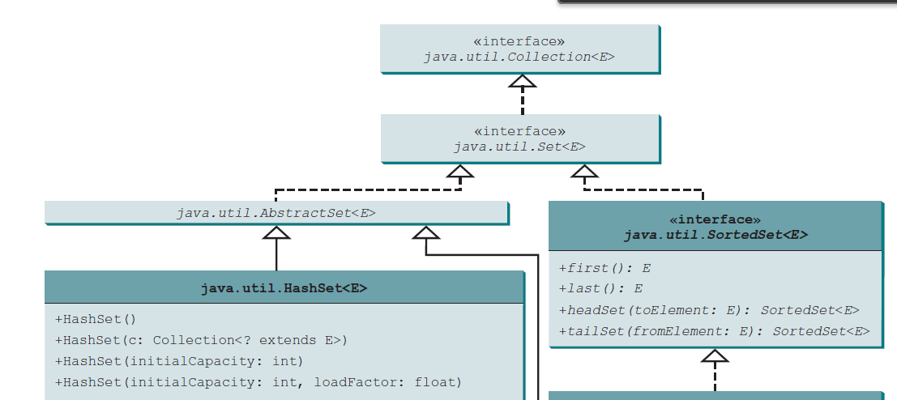
Java data structures
Hashset

Slide 9
Java data structures
Hashset common method
add(E e): This method adds a specific element to the hashset if it is not already present.
remove(Object o): This method removes a specific element from the hashset if it is present.
contains(Object o): This method returns true if the hashset contains the specified element, or false otherwise.
size(): This method returns the number of elements in the hashset.
clear(): This method removes all the elements from the hashset, making it empty.
isEmpty(): This method returns true if the hashset is empty, or false otherwise.
clone(): This method returns a shallow copy of the hashset.
toArray(): This method returns an array containing all the elements in the hashset.
iterator(): This method returns an iterator over the elements in the hashset.

Slide 10
Java data structures
Hashset Example
// import the HashSet class
import java.util.HashSet;
class Main {
public static void main(String[] args) {
// create a HashSet object called colors
HashSet<String> colors = new HashSet<String>();
// add elements to the colors HashSet
colors.add("Red");
colors.add("Blue");
colors.add("Yellow");
// print the colors HashSet
System.out.println("Colors: " + colors);
// get the size of the colors HashSet
int size = colors.size();
System.out.println("Size of colors: " + size);
// loop through the colors HashSet using a for-each loop
System.out.println("Colors using for-each loop:");
for (String color : colors) {
System.out.println(color);
}
}
}
// import the HashSet class
import java.util.HashSet;
class Main {
public static void main(String[] args) {
// create a HashSet object called colors
HashSet<String> colors = new HashSet<String>();
// add elements to the colors HashSet
colors.add("Red");
colors.add("Blue");
colors.add("Yellow");
// print the colors HashSet
System.out.println("Colors: " + colors);
// check if the colors HashSet contains a specific element
boolean hasRed = colors.contains("Red");
System.out.println("Has red: " + hasRed);
// remove an element from the colors HashSet
colors.remove("Yellow");
System.out.println("Colors after removal: " + colors);
}
}

Slide 11
Java data structure
HashMap
A map is a container object that stores a collection of key/value pairs.
It enables fast retrieval, deletion, and updating of the pair through the key.
A map stores the values along with the keys.
The keys are like indexes. In List, the indexes are integers. In Map, the keys can be any objects.
A map cannot contain duplicate keys. Each key maps to one value.
A key and its corresponding value form an entry stored in a map
Hashmap is one of the concrete class implementing Map

Slide 12
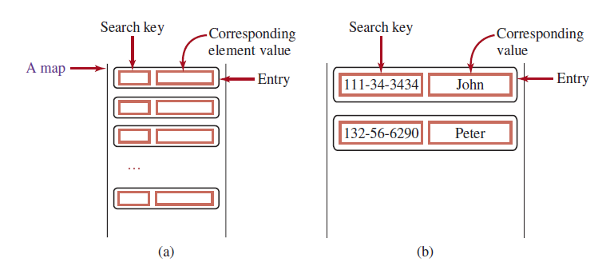
Java data structure
hashmap
Visualization on how value and key are stored when using HashMap

Slide 13
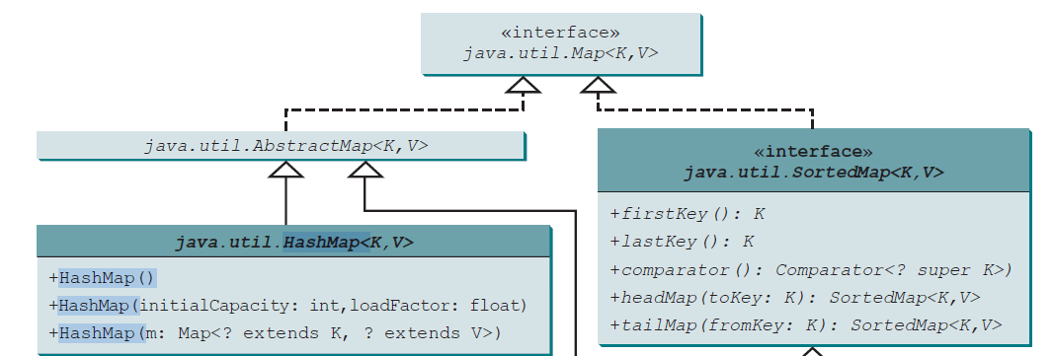
Java data structure
Hashmap

Slide 14
Java data structures
Hashmap common methods
put(key, value) : This method inserts a new key-value pair into the hashmap, or updates the value if the key already exists.
get(key) : This method returns the value associated with the given key, or null if the key is not present in the hashmap.
remove(key) : This method removes the key-value pair from the hashmap, and returns the value that was associated with the key, or null if the key was not present.
containsKey(key) : This method returns true if the hashmap contains the given key, or false otherwise.
containsValue(value) : This method returns true if the hashmap contains at least one key-value pair with the given value, or false otherwise.
size() : This method returns the number of key-value pairs stored in the hashmap.
clear() : This method removes all the key-value pairs from the hashmap, making it empty.
keySet() : This method returns a set view of all the keys in the hashmap.
values() : This method returns a collection view of all the values in the hashmap.
entrySet() : This method returns a set view of all the key-value pairs in the hashmap.

Slide 15
Java data structures
HashMap example
// import the HashMap class
import java.util.HashMap;
class Main {
public static void main(String[] args) {
// create a HashMap object called students
HashMap<String, Integer> students = new HashMap<>();
// add elements to the students HashMap
students.put("Alice", 90);
students.put("Bob", 85);
students.put("Charlie", 95);
// remove an element from the students HashMap
students.remove("Charlie");
System.out.println("Students after removal: " + students);
// get the number of elements in the students HashMap
int size = students.size();
System.out.println("Size of students: " + size);
// loop through the students HashMap using a for-each loop
System.out.println("Students using for-each loop:");
for (String name : students.keySet()) {
System.out.println(name + " : " + students.get(name));
}
}
}
// import the HashMap class
import java.util.HashMap;
class Main {
public static void main(String[] args) {
// create a HashMap object called students
HashMap<String, Integer> students = new HashMap<>();
// add elements to the students HashMap
students.put("Alice", 90);
students.put("Bob", 85);
students.put("Charlie", 95);
// print the students HashMap
System.out.println("Students: " + students);
// get the value associated with a key
int score = students.get("Bob");
System.out.println("Bob's score: " + score);
// check if the students HashMap contains a key
boolean hasAlice = students.containsKey("Alice");
System.out.println("Has Alice: " + hasAlice);
}
}

Slide 16




exercise
Groceries management
You are asked to build a simple console-based groceries management system.
The program must provide a menu with 5 options:
1. Add Item
2. Remove Item
3. Search Item
4. View List
5. Exit
Add Item
Ask the user to input an item name, trim spaces and validate:
Name cannot be empty
Name cannot be duplicate (case insenstivie)
If valid, add to ArrayList.
Remove Item
Ask the user to enter the exact item name to remove (case
Insensitive).
If found, remove the item.
If not found, display error.

Slide 17
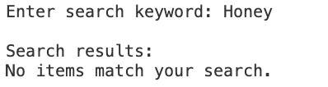

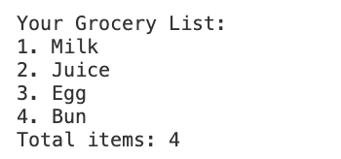
exercise
Groceries management
Search Item
User enters a keyword.
Program shows all matching items (case-insensitive).
View List
Display all groceries in the ArrayList.

Slide 18
Java data structures
references
Daniel Liang, Introduction to Java Programming and Data Structure, 13th edition.

